Slide 1
Beam search for the longest common subsequence problem
Christian Bluma, MariaJ.Blesaa, and ManuelLópez-Ibáñezb
Computers & Operations Research 36 (2009) 3178 – 3186
Speaker: Chong-Jie Wang
Date: Nov. 17, 2009

Slide 2
Abstract
The longest common subsequence problem is a classical string problem that concerns finding the common part of a set of strings. It has several important applications, for example, pattern recognition or com- putational biology. Most research efforts up to now have focused on solving this problem optimally. In comparison, only few works exist dealing with heuristic approaches. In this work we present a determin- istic beam search algorithm. The results show that our algorithm outperforms the current state-of-the-art approaches not only in solution quality but often also in computation time.

Slide 3
Beam search
An incomplete derivative of branch and bound .
The central idea behind BS is to allow the extension of partial solutions in several possible ways.
k_{bw} :beam width
μ≥1 : a parameter of the algorithm

Slide 4

Crucial components of BS
Constructive heuristic : is so-called Best-Next heuristic
Upper bound

Slide 5
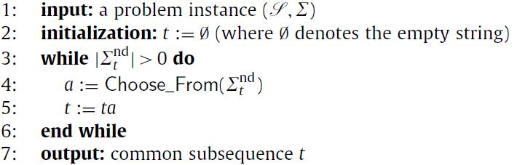
Best-Next heuristic for the LCS problem

Slide 6
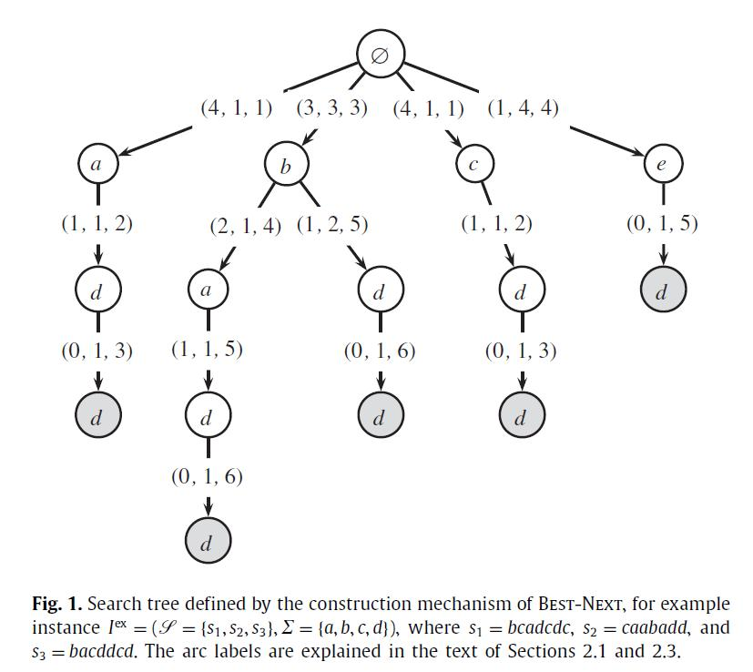

Slide 7
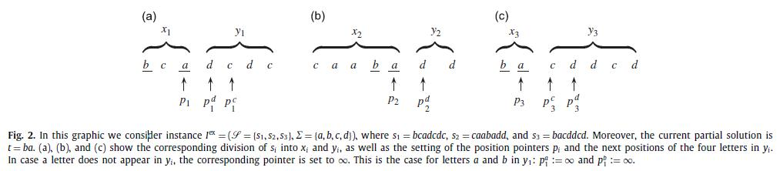

Slide 8
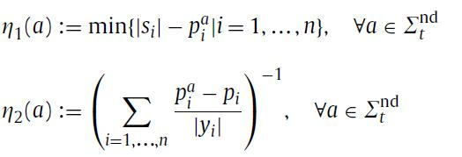
Greedy functions for Choose_from(∑_{t}^{nd})

Slide 9
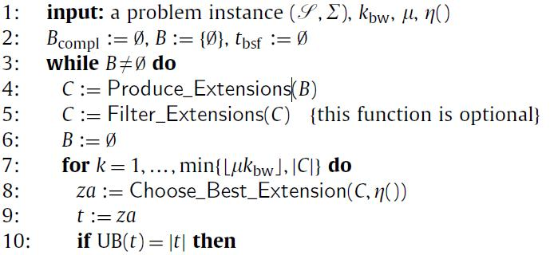
Beam search for the LCS problem(1/2)

Slide 10
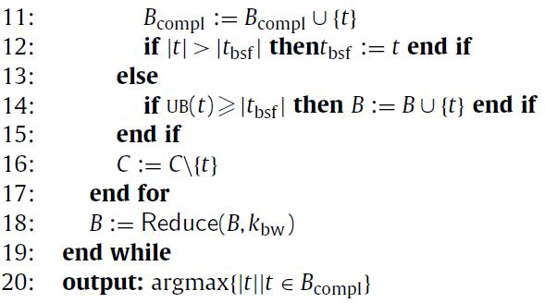
Beam search for the LCS problem(2/2)

Slide 11
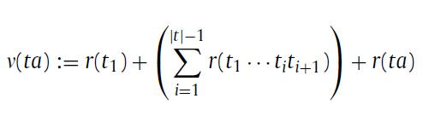
r() : the rank the extention of greedy weight
ex: r(tb)=1 for all a ∈ ∑_{t}^{nd}, η(tb)≥η(ta)

Slide 12
Experiments(1/3)
BB: introduced by Blum and Blesa
A number of strings n and a length l, a base string of length l was created by randomly gen- erating letters from ∑.
Ten instances were generated for each of the 80 combinations of | ∑ | ∈ {2, 4,8,24}, n ∈ {10, 100} and l ∈ {100, 200,300,...,1000}.

Slide 13
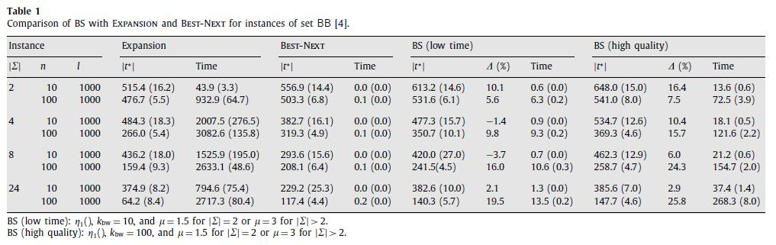

Slide 14
Experiments(2/3)
ES: introduced by Easton and Singireddy
It is composed of 50 instances per combination of | ∑|, n, and l. These instances were created by sequentially generating each letter with a probability of 1/| ∑|.
low time : k_{bw} = 10, η₂() and μ= 1.5
high quality : k_{bw} = 100, η₂() and μ= 1.5 for | ∑| = 2 and
k_{bw} = 50, η₂() and μ= 3 for | ∑| > 2

Slide 15
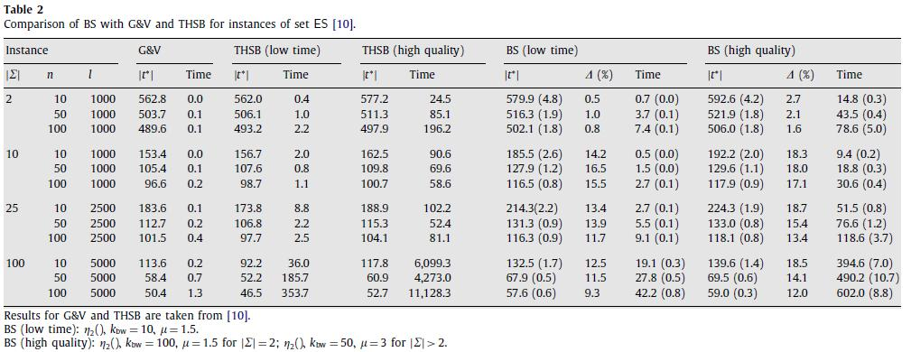

Slide 16
Experiments(3/3)
ST: stems from Shyu and Tsai
Their instances are biologically inspired, and thus they consider an alphabet of size | ∑ | = 4, corresponding to DNA sequences, or of size | ∑ | = 20, corresponding to protein sequences.
Shyu and Tsai studied three different types of in- stances. One was randomly generated, presumably in the same way as ES instances. The other two sets consist of real DNA and protein sequences of rats and viruses.

Slide 17
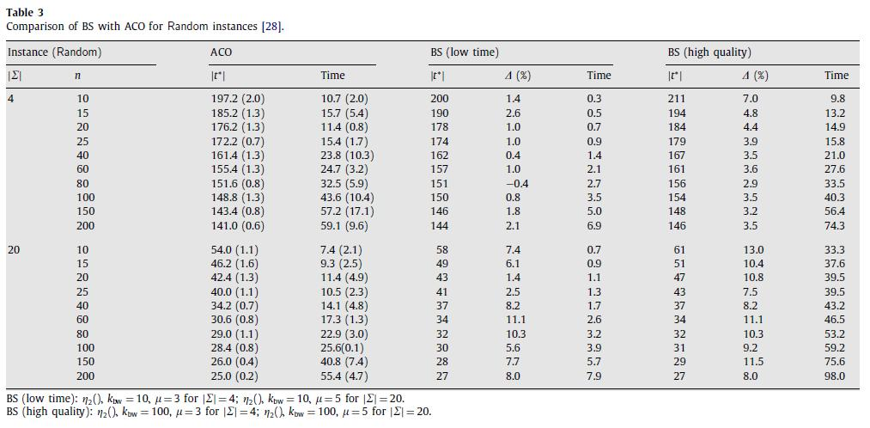

Slide 18
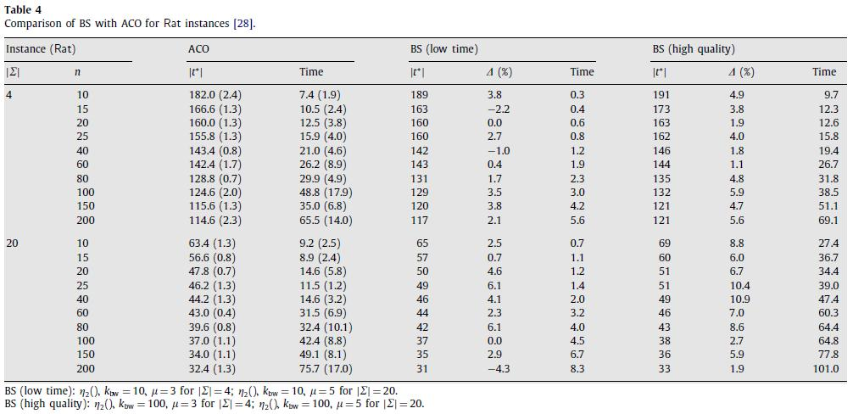

Slide 19
Thanks for your listening

